Slide 1
Unsupervised Learning
Dimensionality Reduction
IUT AI Student Chapter

Slide 2
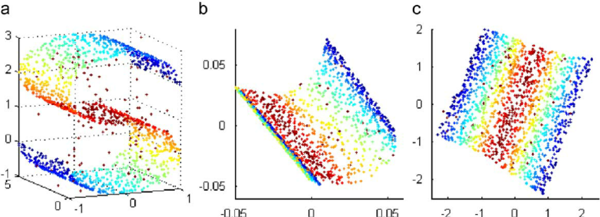
Dimensionality Reduction
Reducing the number of random variables by obtaining a set of principal variables.
higher number of features -> harder it gets to visualize
training set and then work on it

Slide 3
NOTE
Feature Selection
Feature Extraction

Slide 4
Non Linear models
Linear models

Slide 5
Principal Component Analysis
Very popular technique
Find a reduced subspace which maintains most of the variability of the data
d orthogonal vectors that form a new coordinate system which are ’principal components’

Slide 6
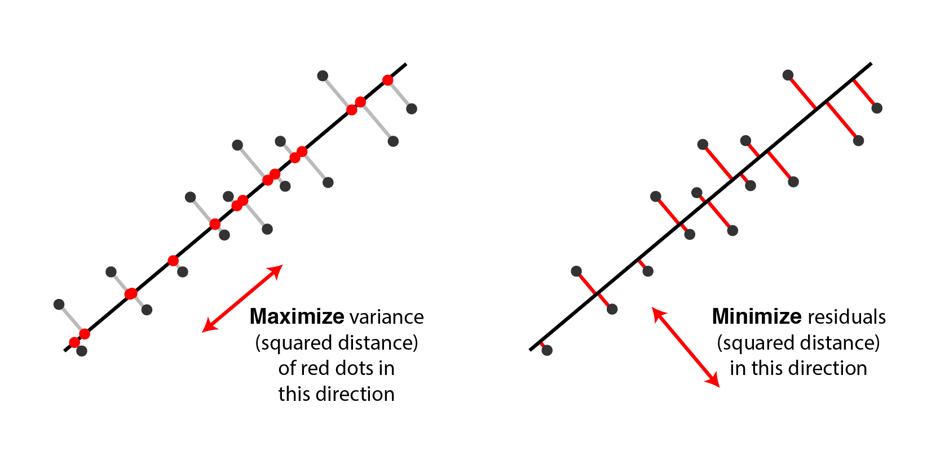

Slide 7
Intuition

Slide 8
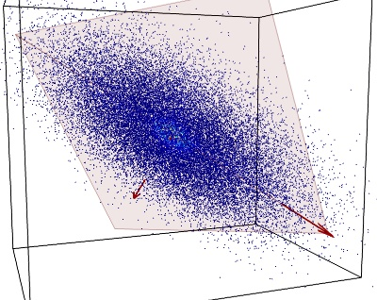
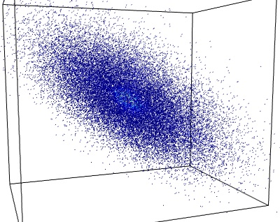
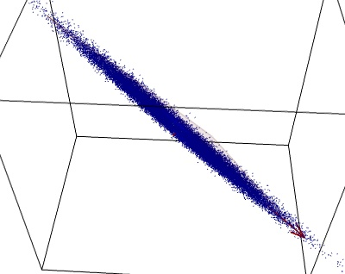
Intuition

Slide 9
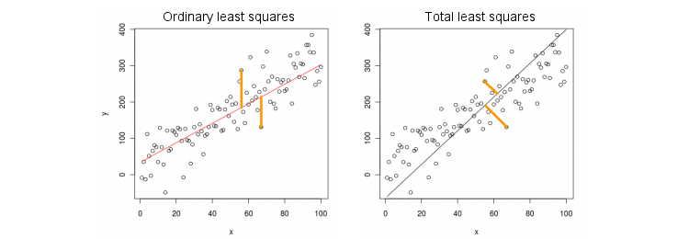
Warning

Slide 10
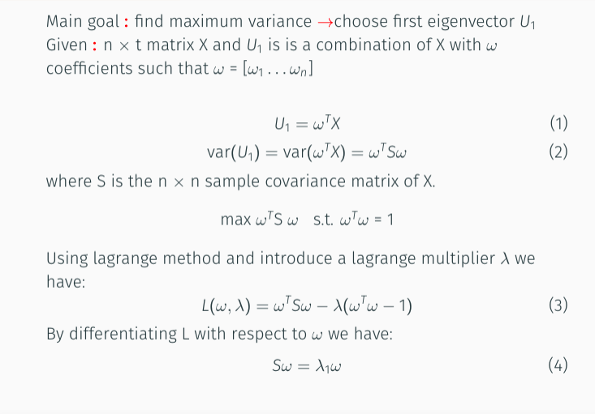
Proof

Slide 11
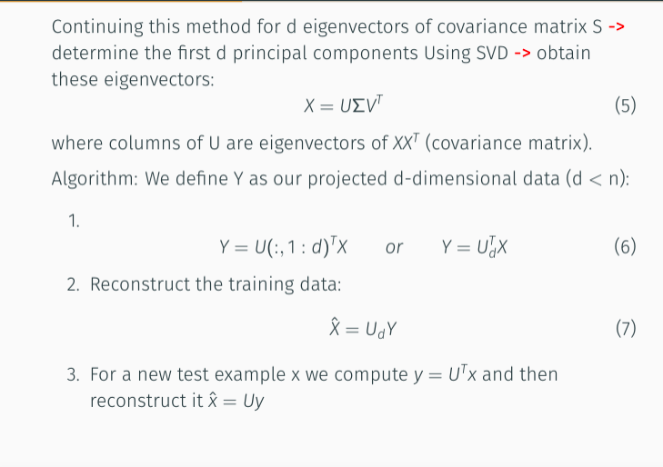
Proof

Slide 12
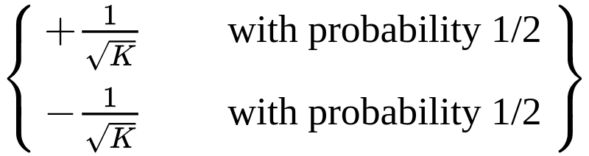
Random Projection
for the cases with large number of samples
W[i,j] =

Slide 13
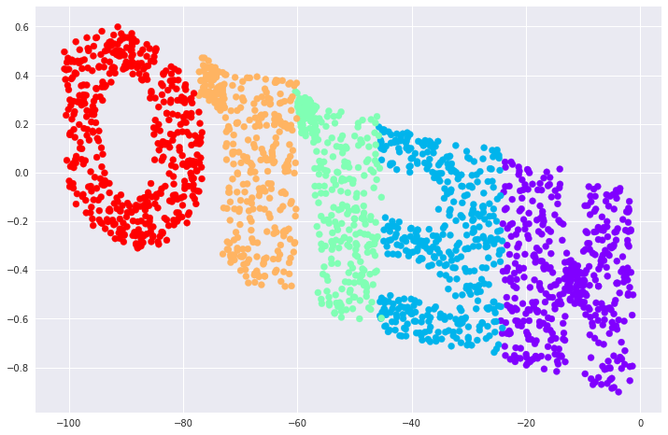
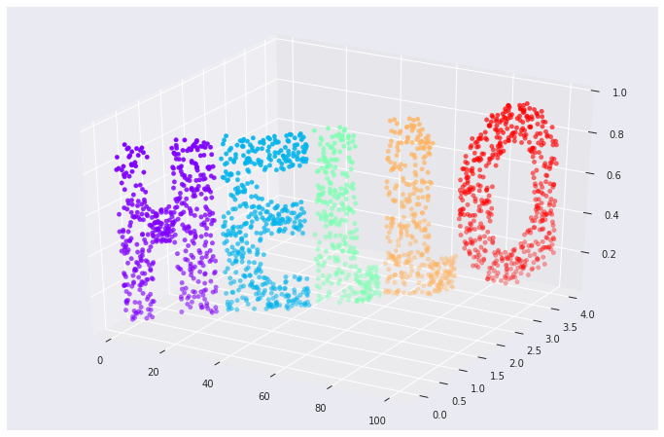
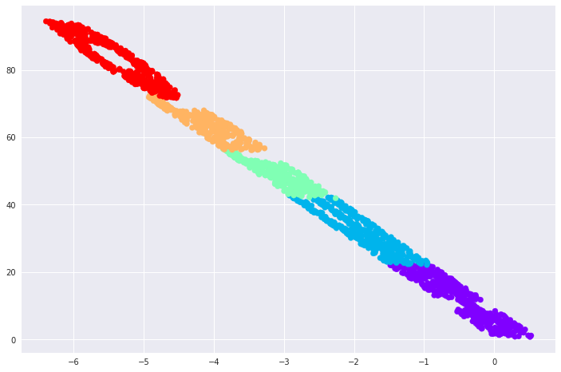
Comparison
PCA
Random Projection

Slide 14
Non-Linear Methods

Slide 15
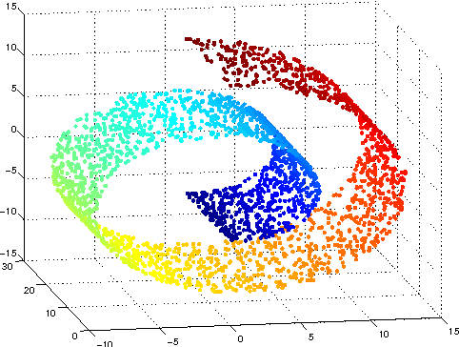
What happens if we have a manifold ?

Slide 16
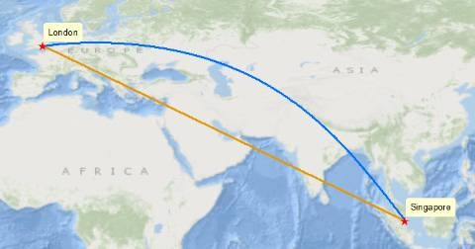
New definition for Distance
Euclidean Distance
Geodesic Distance

Slide 17
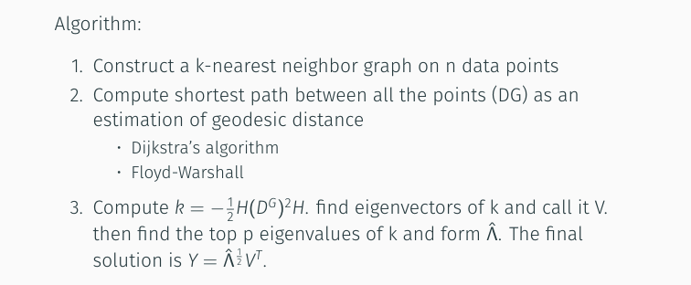
Isomap

Slide 18
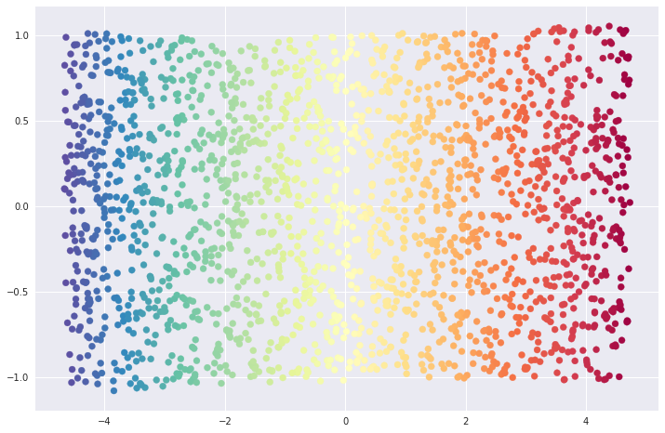
Example

Slide 19
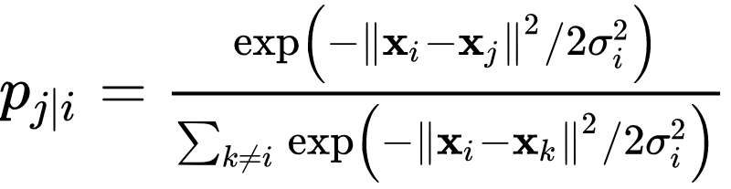
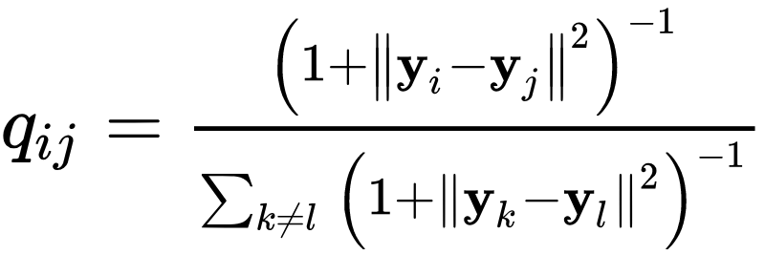
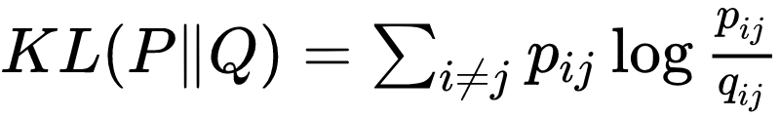
T-SNE (t-Distributed Stochastic Neighbor Embedding )

Slide 20
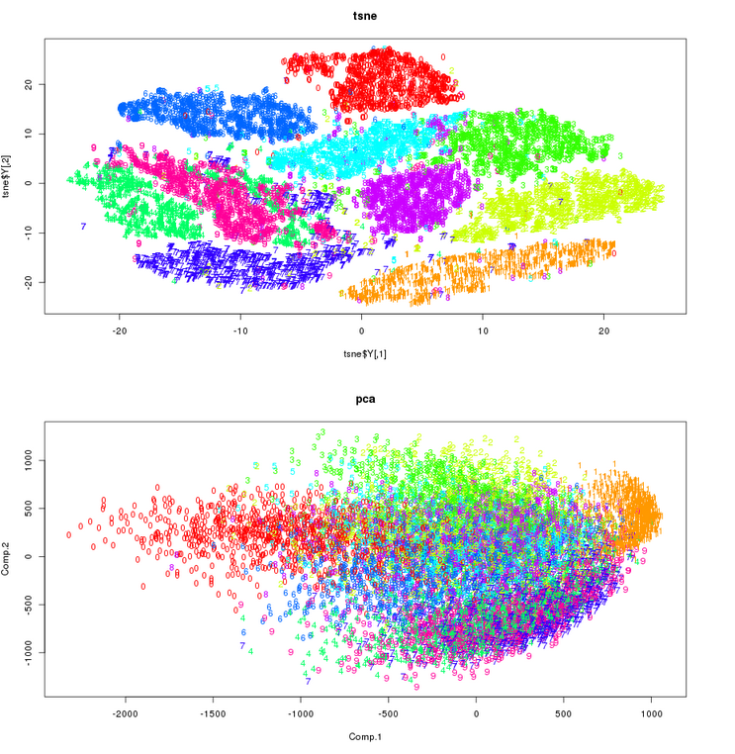
T-SNE

